Slide 1
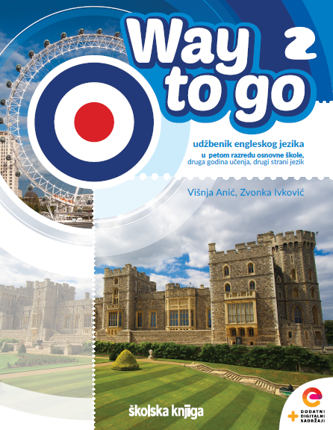

UNIT 5: Me and the World
Holidays in
Australia

Slide 2
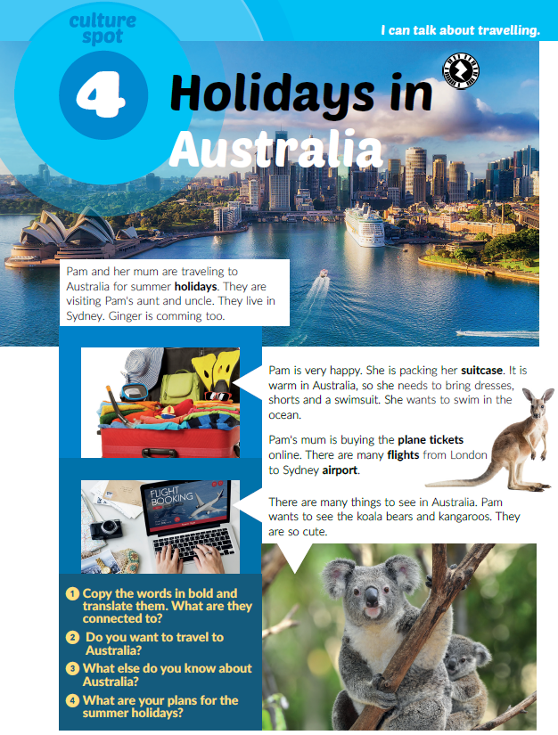
How many countries in the world have you visited so far?
Did you travel by boat / train / bus / plane?
What country is Pam visiting?
What language do people speak in Australia?
Read the text. What are the words in bold connected to?
Do you want to travel to Australia?
Why? Why not?
What else do you know about Australia?

Slide 3
Click on the following link and watch a video about Australia.
https://www.e-sfera.hr/dodatni-digitalni-sadrzaji/3f6f7d61-12b1-471e-9dc4-7ab86438e5f3/
While watching, find three things that are the same in Croatia and in Australia.
Watch the video again. What are the differences between Croatia and Australia?
What are your plans for the summer?
Click on the following link and choose Self check. Complete the tasks.
https://www.e-sfera.hr/dodatni-digitalni-sadrzaji/3f6f7d61-12b1-471e-9dc4-7ab86438e5f3/
Then, play the game on the following link: https://wordwall.net/embed/ef9e0442b7dd41d0841f932fab8758c6?themeId=1&templateId=36

Slide 4
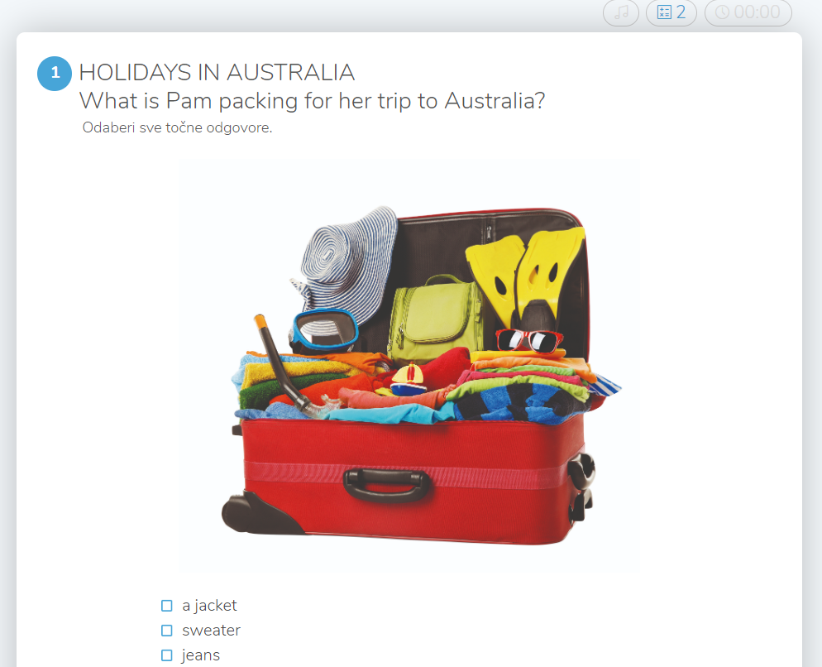
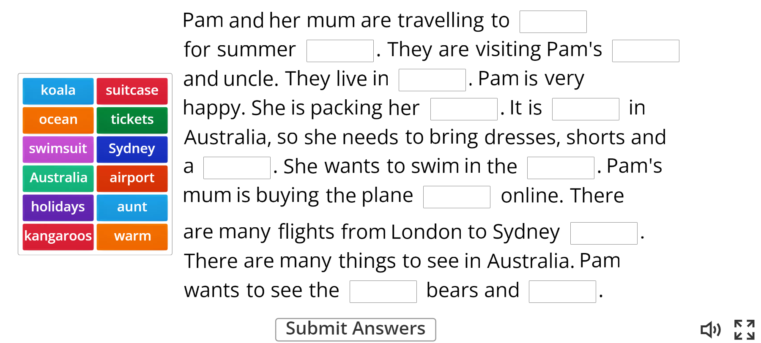
Click on the link and choose Self check. Complete the tasks.
https://www.e-sfera.hr/dodatni-digitalni-sadrzaji/3f6f7d61-12b1-471e-9dc4-7ab86438e5f3/
Play the game:
https://wordwall.net/embed/ef9e0442b7dd41d0841f932fab8758c6?themeId=1&templateId=36

